Slide 1

I believe in ….
the communion of saints

Slide 2
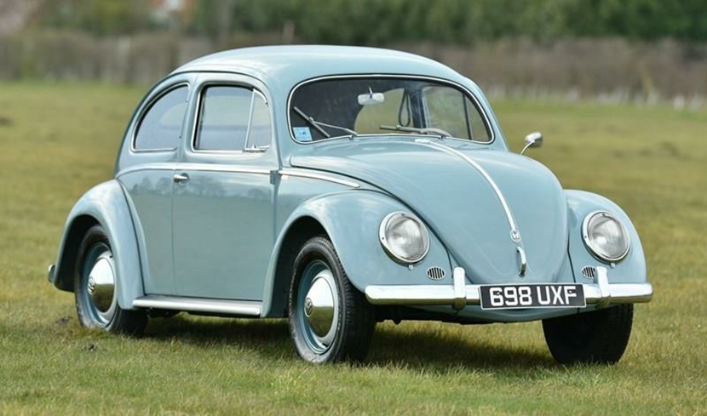
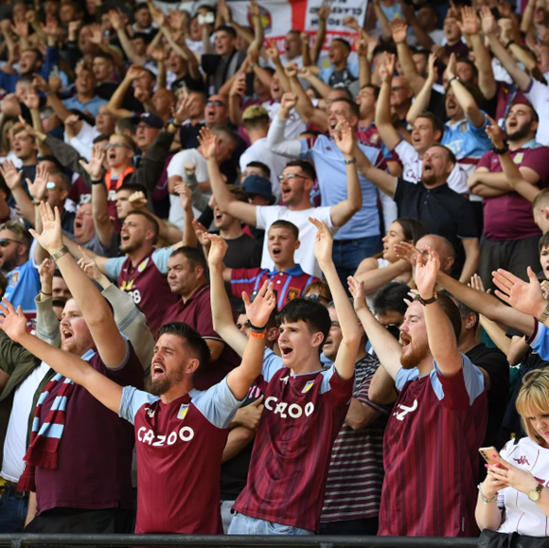
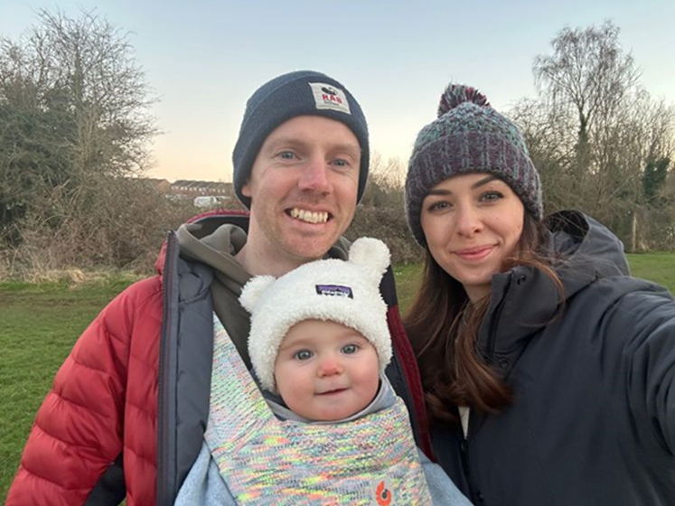
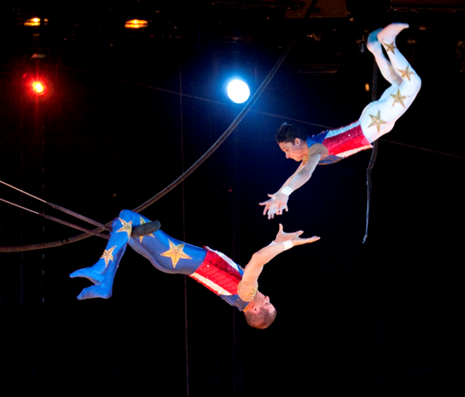

Slide 3
Relationship with Jesus

Slide 4
Fellowship with one another

Slide 5
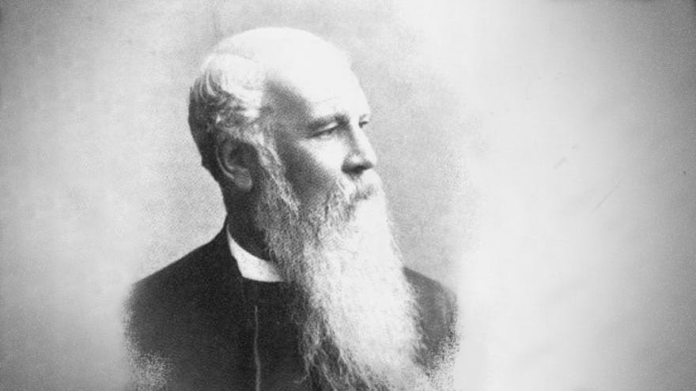
Who, indeed, can describe the pleasure with which the members of Christ’s flock do meet each other face-to-face? They may have been strangers before, but it's just wonderful to observe how soon they seem to understand each other. There seems a thorough oneness of opinion… So that one would think they had known each other for years. They seem, indeed to feel they are servants of one and the same Master, members of the same family, and have been converted by one and the same Spirit. They have one Lord, one Faith, one baptism

Slide 6
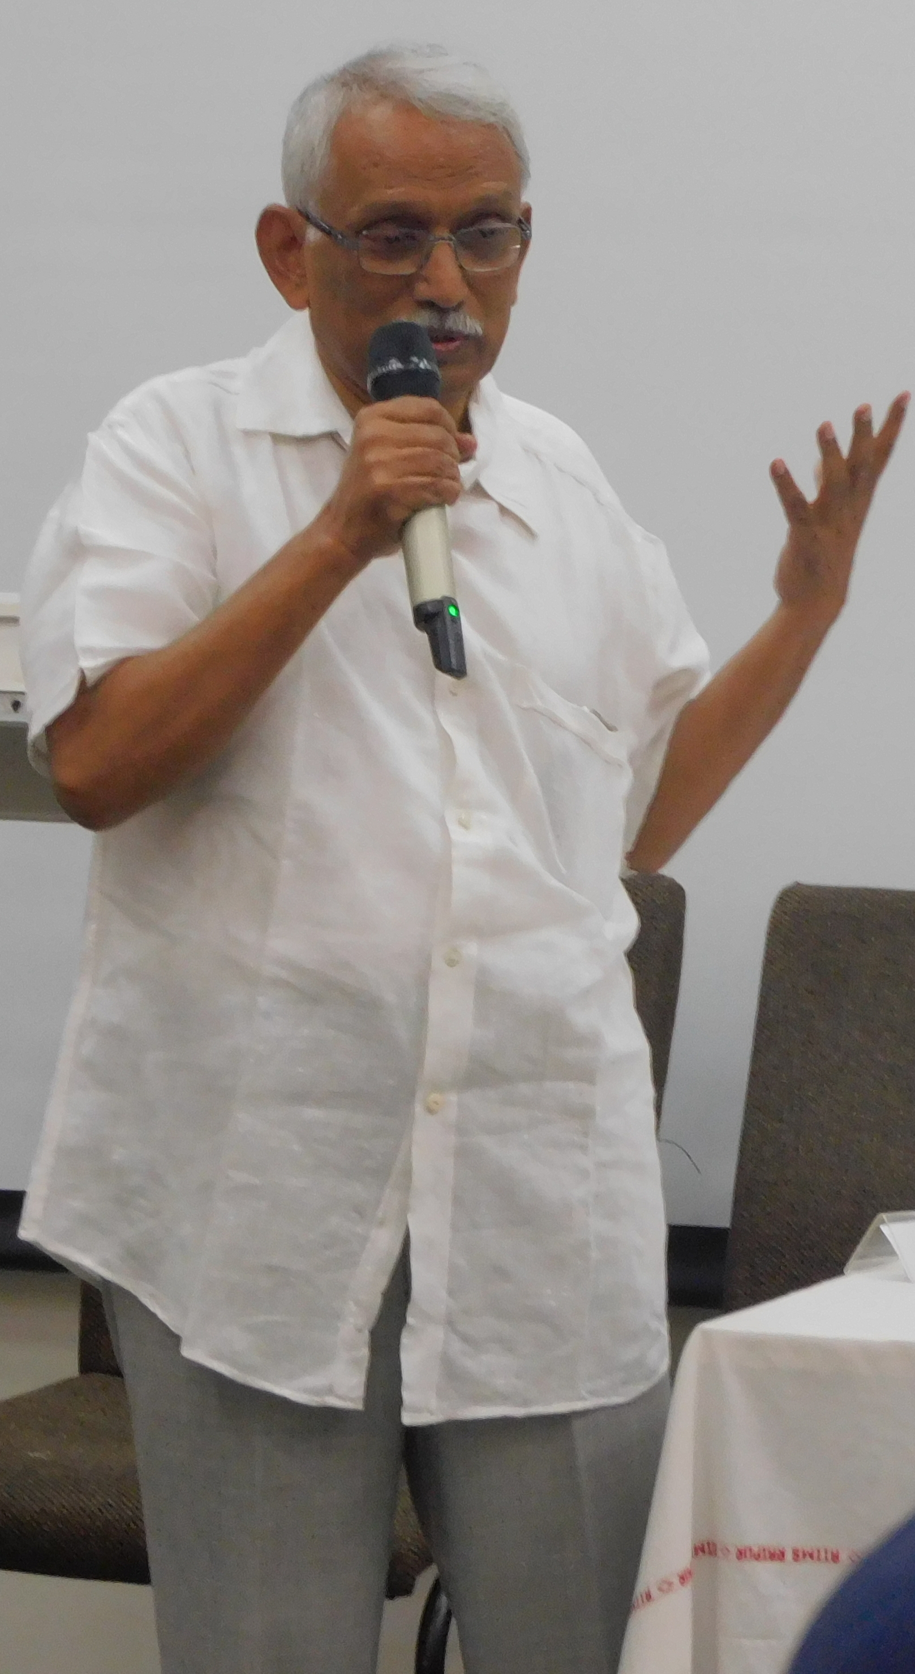

Slide 7
